Slide 1


Self-Introduction
Who am I?
Name: KK
稱謂: KK
Role: English Tutor
職責: 英語導師
Topic: Introduction to Artificial Intelligence in Data Analysis, Conflict Resolution, and Productivity
課堂主題: 人工智能應用入門【數據分析，糾紛處理，生產力促進】
Reason I teach: To preserve hope in Hong Kong’s next generation
執教原因: 為香港的下一代保留對明天的期盼
My background: I am a researcher at University of Toronto studying information systems and data science. Prior to research, I worked for data provider, stock exchange, and multi-national banks in the financial industry. I am not a secondary school teacher and have no plans to teach in non-university setting. I do volunteer English Teaching for underprivileged students to assist them in upward social mobility and preserve hope for next generation Hong Kongers.
我的背景: 我是一名多倫多大學數據科學與信息系統設計的研究員。做研究之前，我曾供職於歐美銀行等跨國金融機構。我的專業不是一名教師，未來除大學教授外亦沒有做教師的意願。在這裏教英語的原因是爲了培育下一代香港人的希望，為你們未來在社會中上流提供一扇窗戶。

Slide 2
Don’t Mute Yourself. Ask questions whenever you wish. I am here for you.

Slide 3


What is your dream?
Give me a chance to learn about you – one by one ☺
Name
Name
Name
Name

Slide 4


Introduction to AI in Data Analysis
Understanding Data in Everyday Life
KK

Slide 5






What are we doing here?
Executive Summary
Learning through English and AI
Language in Analytics
Use Case Scenario
Vocabulary
課堂内容為現時大學研究人員日常使用的基礎人工智能技巧，中學生有不明白的地方是非常正常的。請不要覺得怕醜或自己校内成績不好而不敢發問，不論平日多厲害的同學在這裏的起步點都是一樣的。
Introduction Data Analysis Use-Case Vocabulary Reflection

Slide 6

What is Data Analysis?
Turning Data into Information to improve our understanding
Definition of Data Analysis
Data analysis, the process of systematically collecting, cleaning, transforming, describing, modeling, and interpreting data, generally employing statistical techniques.
Eldridge, Stephen. "data analysis". Encyclopedia Britannica, 15 Dec. 2023, https://www.britannica.com/science/data-analysis. Accessed 22 January 2024.
Application of Data Analysis
ChatGPT is fine-tuned from GPT-3.5, a language model trained to produce text. ChatGPT was optimized for dialogue by using Reinforcement Learning with Human Feedback (RLHF) – a method that uses human demonstrations and preference comparisons to guide the model toward desired behavior.
Introduction Data Analysis Use-Case Vocabulary Reflection

Slide 7

Let’s have fun!
Anyone played Mario Kart before? ☺
Start by selecting your character!
Introduction Data Analysis Use-Case Vocabulary Reflection

Slide 8





Let’s have fun
Choose your favourite character for Mario Kart
Mario
Luigi
Yoshi
Peach
Donkey Kong
Introduction Data Analysis Use-Case Vocabulary Reflection

Slide 9
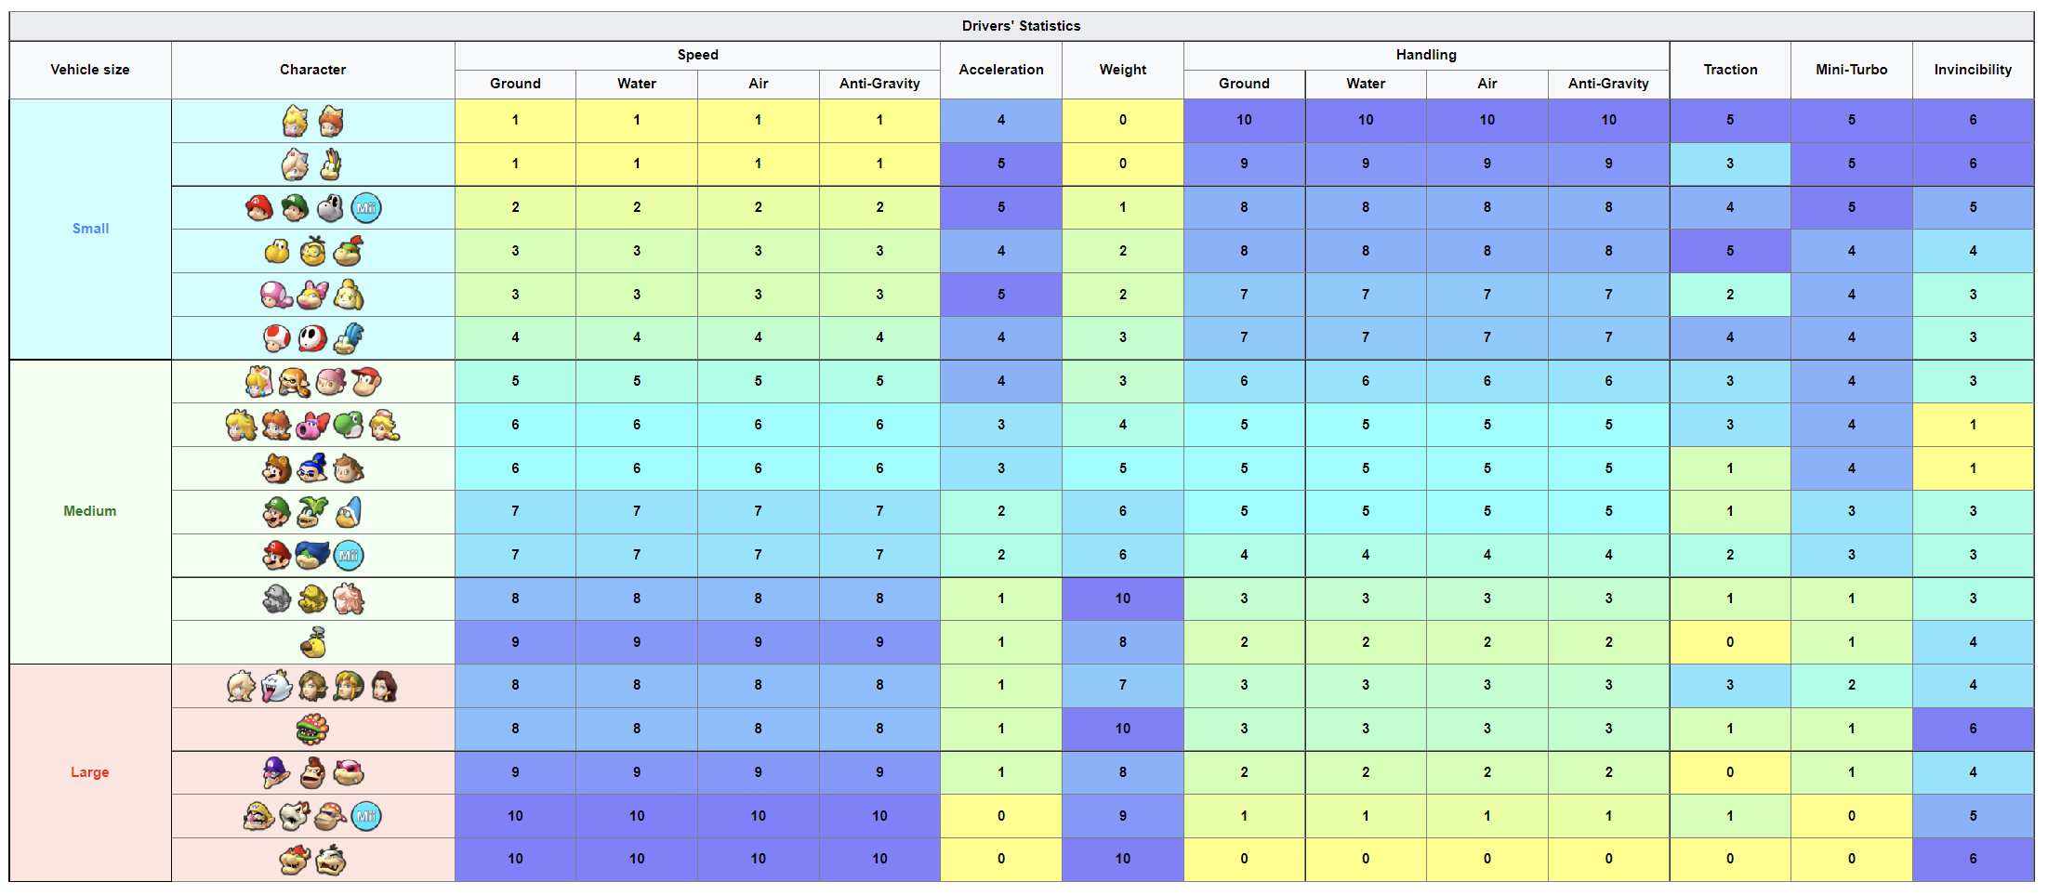
Do you really know who you are?
What are your strength? ☺
Who are you?
Introduction Data Analysis Use-Case Vocabulary Reflection

Slide 10

Interpret data about yourself
Your specifications
Who are you?
 |  |  |  |  | Acceleration | Weight |  |  |  |  | Traction | Mini-Turbo | Invincibility
 | Ground | Water | Air | Anti-Gravity |  |  | Ground | Water | Air | Anti-Gravity
Small | 1 | 1 | 1 | 1 | 4 | 0 | 10 | 10 | 10 | 10 | 5 | 5 | 6
 | 1 | 1 | 1 | 1 | 5 | 0 | 9 | 9 | 9 | 9 | 3 | 5 | 6
 | 2 | 2 | 2 | 2 | 5 | 1 | 8 | 8 | 8 | 8 | 4 | 5 | 5
 | 3 | 3 | 3 | 3 | 4 | 2 | 8 | 8 | 8 | 8 | 5 | 4 | 4
 | 3 | 3 | 3 | 3 | 5 | 2 | 7 | 7 | 7 | 7 | 2 | 4 | 3
 | 4 | 4 | 4 | 4 | 4 | 3 | 7 | 7 | 7 | 7 | 4 | 4 | 3
Medium | 5 | 5 | 5 | 5 | 4 | 3 | 6 | 6 | 6 | 6 | 3 | 4 | 3
 | 6 | 6 | 6 | 6 | 3 | 4 | 5 | 5 | 5 | 5 | 3 | 4 | 1
 | 6 | 6 | 6 | 6 | 3 | 5 | 5 | 5 | 5 | 5 | 1 | 4 | 1
 | 7 | 7 | 7 | 7 | 2 | 6 | 5 | 5 | 5 | 5 | 1 | 3 | 3
 | 7 | 7 | 7 | 7 | 2 | 6 | 4 | 4 | 4 | 4 | 2 | 3 | 3
 | 8 | 8 | 8 | 8 | 1 | 10 | 3 | 3 | 3 | 3 | 1 | 1 | 3
 | 9 | 9 | 9 | 9 | 1 | 8 | 2 | 2 | 2 | 2 | 0 | 1 | 4
Large | 8 | 8 | 8 | 8 | 1 | 7 | 3 | 3 | 3 | 3 | 3 | 2 | 4
 | 8 | 8 | 8 | 8 | 1 | 10 | 3 | 3 | 3 | 3 | 1 | 1 | 6
 | 9 | 9 | 9 | 9 | 1 | 8 | 2 | 2 | 2 | 2 | 0 | 1 | 4
 | 10 | 10 | 10 | 10 | 0 | 9 | 1 | 1 | 1 | 1 | 1 | 0 | 5
 | 10 | 10 | 10 | 10 | 0 | 10 | 0 | 0 | 0 | 0 | 0 | 0 | 6
Introduction Data Analysis Use-Case Vocabulary Reflection

Slide 11







What do you do after you select your character?
Select your kart, but how?
How do you select your Kart?
Define the desired outcome = WIN
Understand the variable (Body, Tire, Glider)
https://rb.gy/cukrkd
Introduction Data Analysis Use-Case Vocabulary Reflection

Slide 12
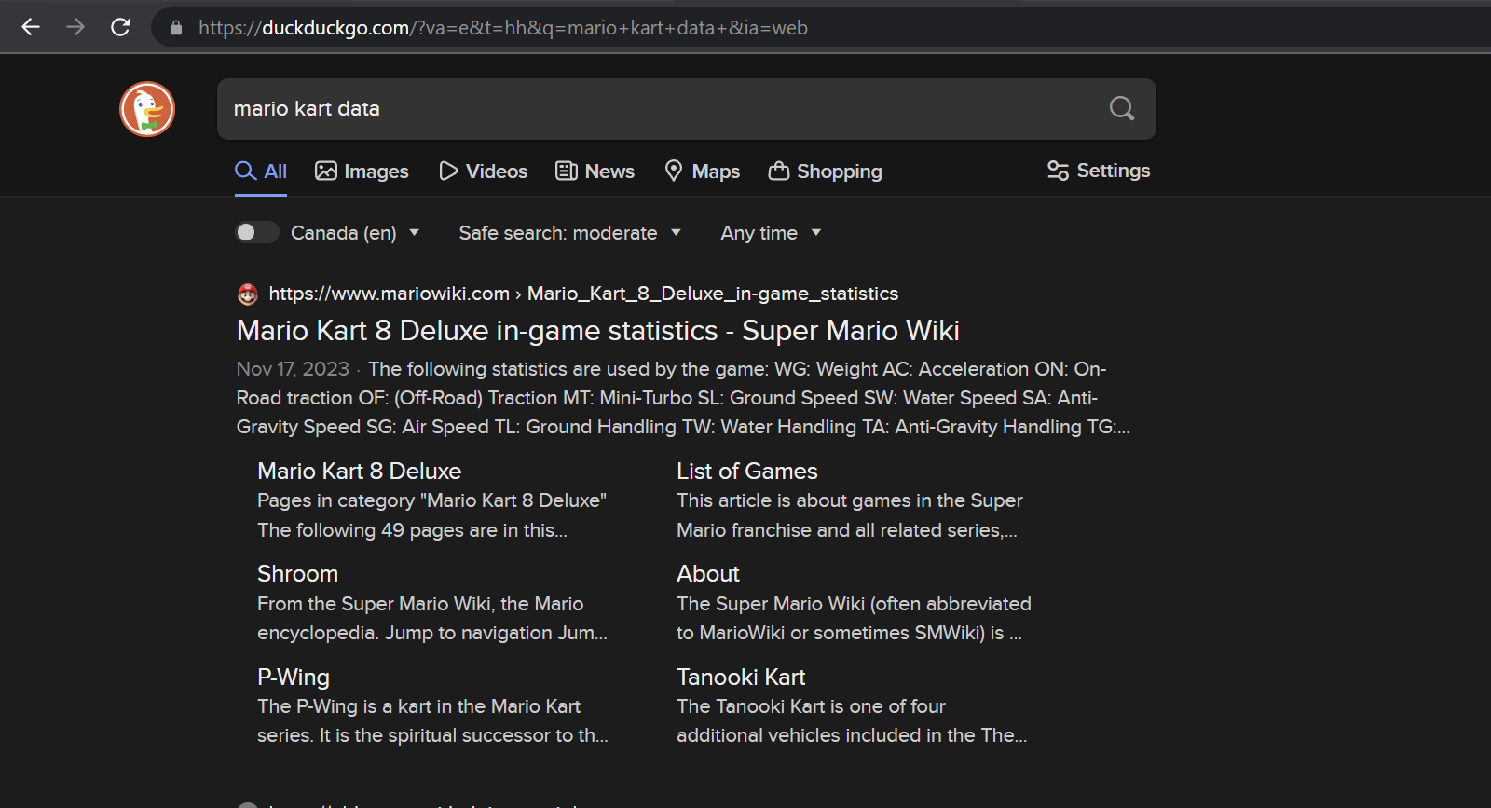

Step 1 – where to find suitable data?
Below table shows statistics for body of karts
https://rb.gy/z1qj8z
Introduction Data Analysis Use-Case Vocabulary Reflection

Slide 13
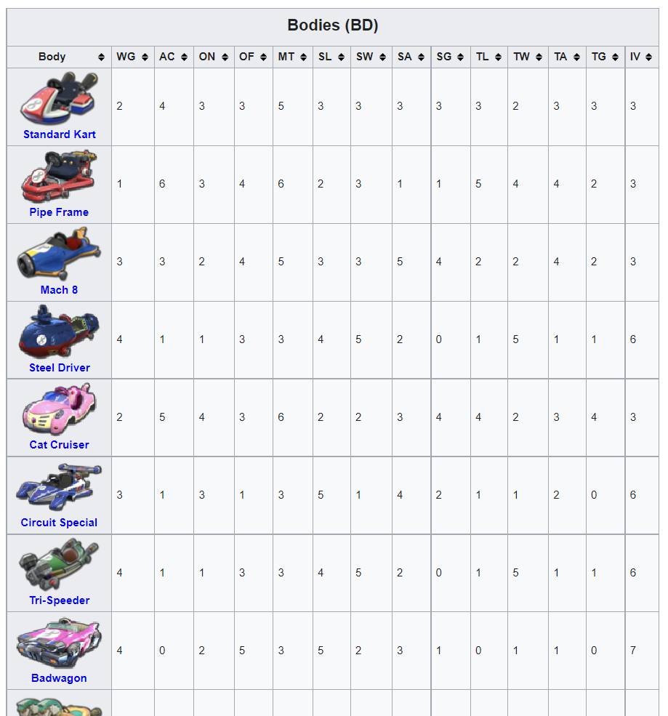
Step 2: Data on Bodies of the Kart
We want structured table, easier for AI to understand
https://rb.gy/z1qj8z
Introduction Data Analysis Use-Case Vocabulary Reflection

Slide 14
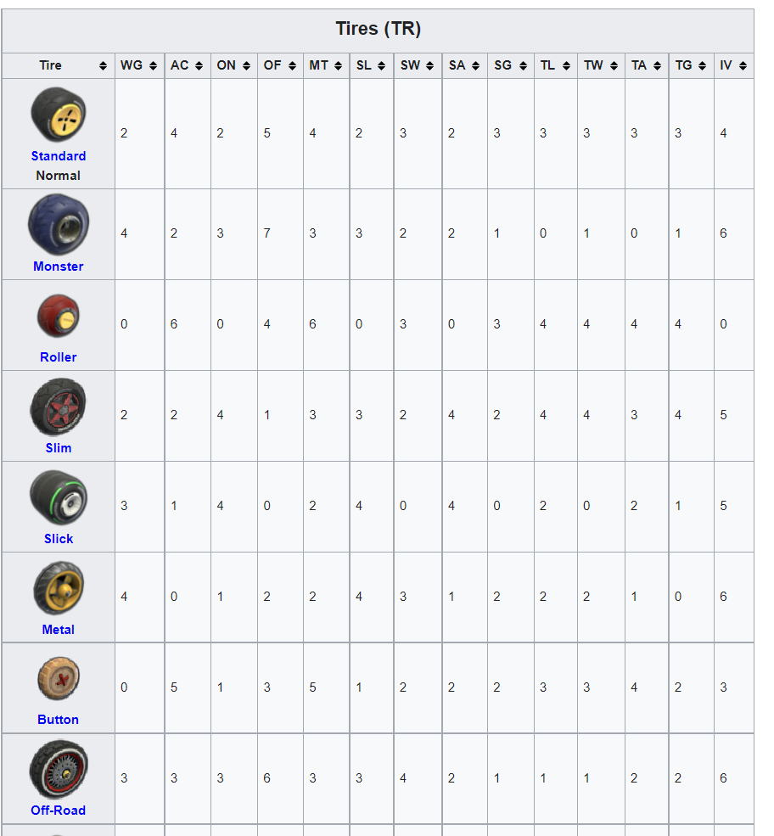
Step 2: Data on Tires of the Kart
We want structured table, easier for AI to understand
https://rb.gy/z1qj8z
Introduction Data Analysis Use-Case Vocabulary Reflection

Slide 15
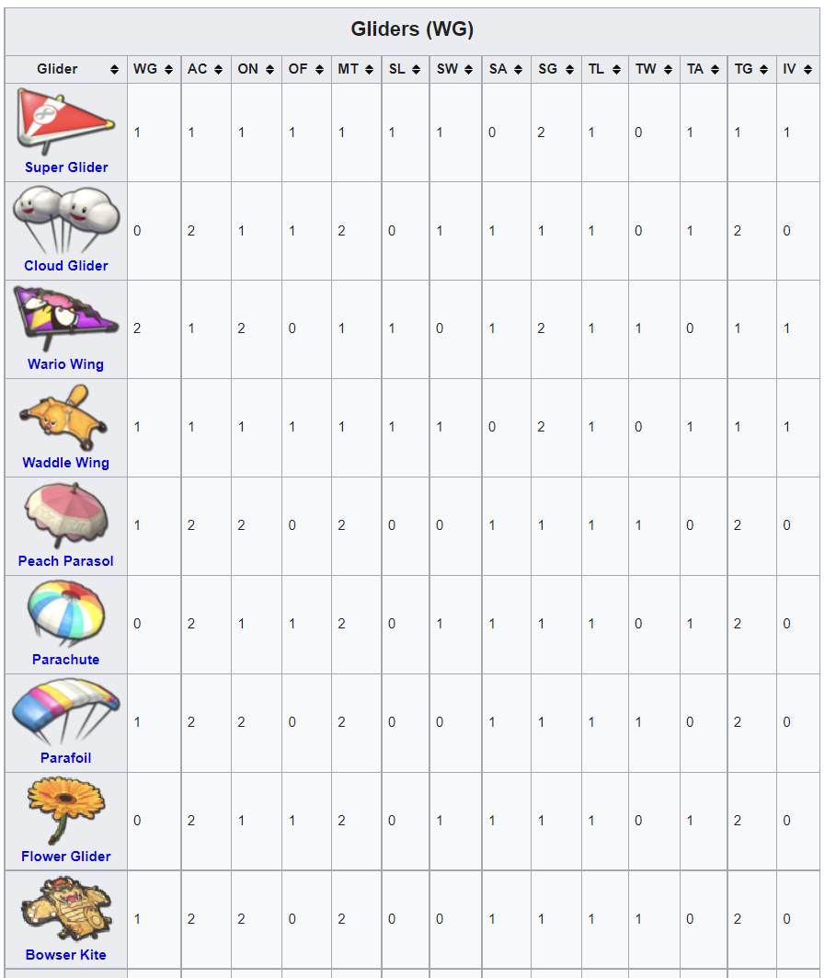
Step 2: Data on Gliders of the Kart
We want structured table, easier for AI to understand
https://rb.gy/z1qj8z
Introduction Data Analysis Use-Case Vocabulary Reflection

Slide 16


Let’s use AI to see which combination is your best car?
We will do this together. You give instructions, I will do it for you ☺
What is your best kart?
What is your best kart?
What is your best kart?
What is your best kart?
Remember your combination so you know how to win in your next Mario Kart Tournament
Introduction Data Analysis Use-Case Vocabulary Reflection

Slide 17

Summary
What English have you learned? ☺
Vocab for Exam
Optimization
Data Analysis
Structured Data Models
Raw Data
Text Mining
Systematically
Interpret
Sentence Structure
Given the fact that……(a condition),…… (a condition related to mentioned condition).
Introduction Data Analysis Use-Case Vocabulary Reflection

Slide 18

Summary
What English have you learned? ☺
Vocab for Exam
Optimization
Data Analysis
Structured Data Models
Raw Data
Text Mining
Systematically
Interpret
Sentence Structure
Given the fact that……(a condition),…… (a condition related to mentioned condition).
Introduction Data Analysis Use-Case Vocabulary Reflection

Slide 19
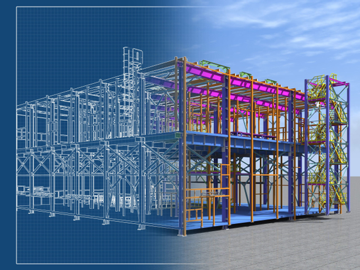
Summary
What English have you learned? ☺
Vocab for Exam
Optimization
Data Analysis
Structured Data Models
Raw Data
Text Mining
Systematically
Interpret
Sentence Structure
Given the fact that……(a condition),…… (a condition related to mentioned condition).
Introduction Data Analysis Use-Case Vocabulary Reflection

Slide 20
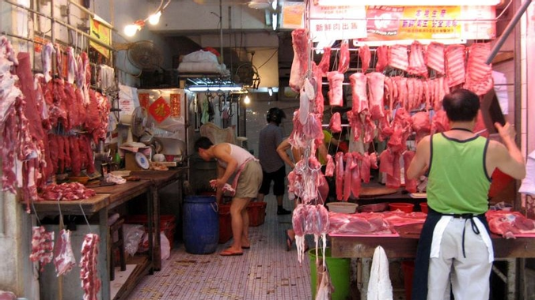
Summary
What English have you learned? ☺
Vocab for Exam
Optimization
Data Analysis
Structured Data Models
Raw Data
Text Mining
Systematically
Interpret
Sentence Structure
Given the fact that……(a condition),…… (a condition related to mentioned condition).
Introduction Data Analysis Use-Case Vocabulary Reflection

Slide 21

Summary
What English have you learned? ☺
Vocab for Exam
Optimization
Data Analysis
Structured Data Models
Raw Data
Text Mining
Systematically
Interpret
Sentence Structure
Given the fact that……(a condition),…… (a condition related to mentioned condition).
Introduction Data Analysis Use-Case Vocabulary Reflection

Slide 22

Summary
What English have you learned? ☺
Vocab for Exam
Optimization
Data Analysis
Structured Data Models
Raw Data
Text Mining
Systematically
Interpret
Sentence Structure
Given the fact that……(a condition),…… (a condition related to mentioned condition).
Introduction Data Analysis Use-Case Vocabulary Reflection

Slide 23

Summary
What English have you learned? ☺
Vocab for Exam
Optimization
Data Analysis
Structured Data Models
Raw Data
Text Mining
Systematically
Interpret
Sentence Structure
Given the fact that……(a condition),…… (a condition related to mentioned condition).
Introduction Data Analysis Use-Case Vocabulary Reflection

Slide 24
Tell me what you have done just now in English
Use at least one vocabulary about AI ☺
What have we learned?
What have we learned?
What have we learned?
What have we learned?
Active participants gets a coin
Introduction Data Analysis Use-Case Vocabulary Reflection

Slide 25

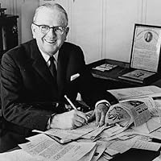
The End.
“Shoot for the moon. Even if you miss, you'll land among the stars.”
― Norman Vincent Peale

Slide 26

Introduction to AI in Conflict Resolution
Natural Language Processing (NLP) to resolve conflicts
KK

Slide 27
What are we doing here?
Executive Summary
How to study English?
Language in Analytics
Use Case Scenario
Vocabulary
Introduction NLP Use-Case Vocabulary Reflection

Slide 28


What is Natural Language Processing
How does machine understand human language
Definition of Natural Language Processing (NLP)
Natural language processing (NLP) is a form of artificial intelligence (AI) that allows computers to understand human language, whether it be written, spoken, or even scribbled.
Andrew Yan-Tak Ng (吳恩達)
Founder of Google Brain and Coursera. Second Generation Hong Konger
Introduction NLP Use-Case Vocabulary Reflection

Slide 29
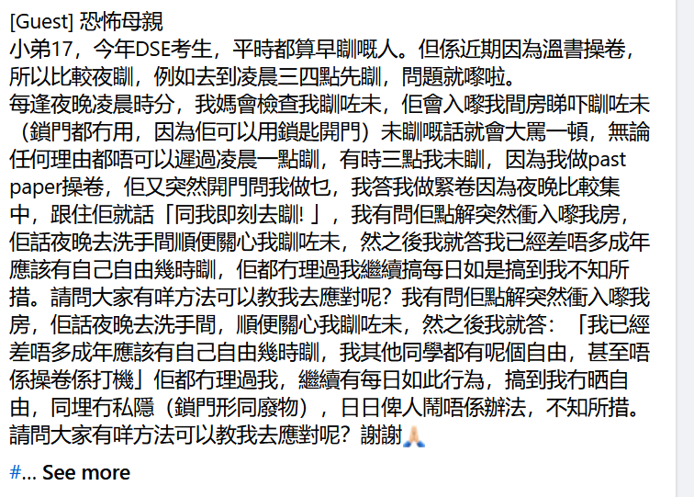

What would you do in dealing with conflicts?
This generation likes social media, below is a post from Facebook schools.secret (名校 secret)
What will you do in a situation like this?
Introduction NLP Use-Case Vocabulary Reflection
Notes:
https://www.facebook.com/schools.secrets/

Slide 30
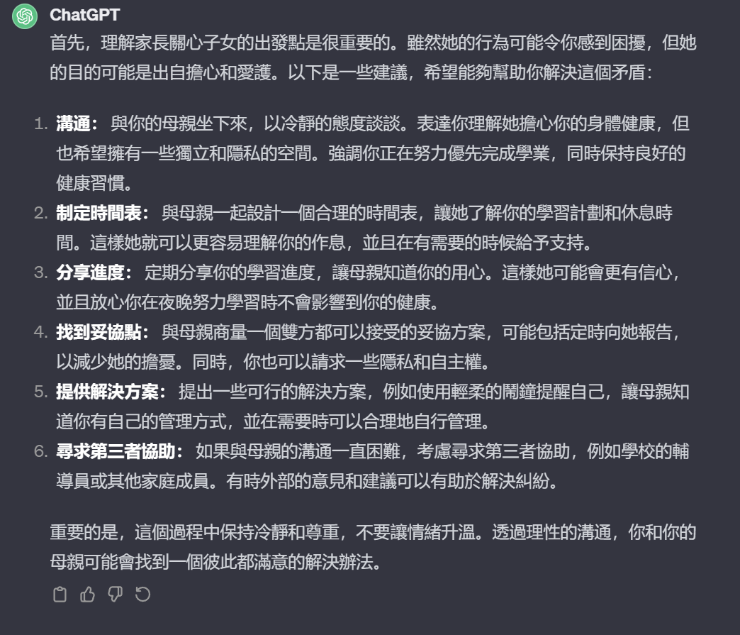
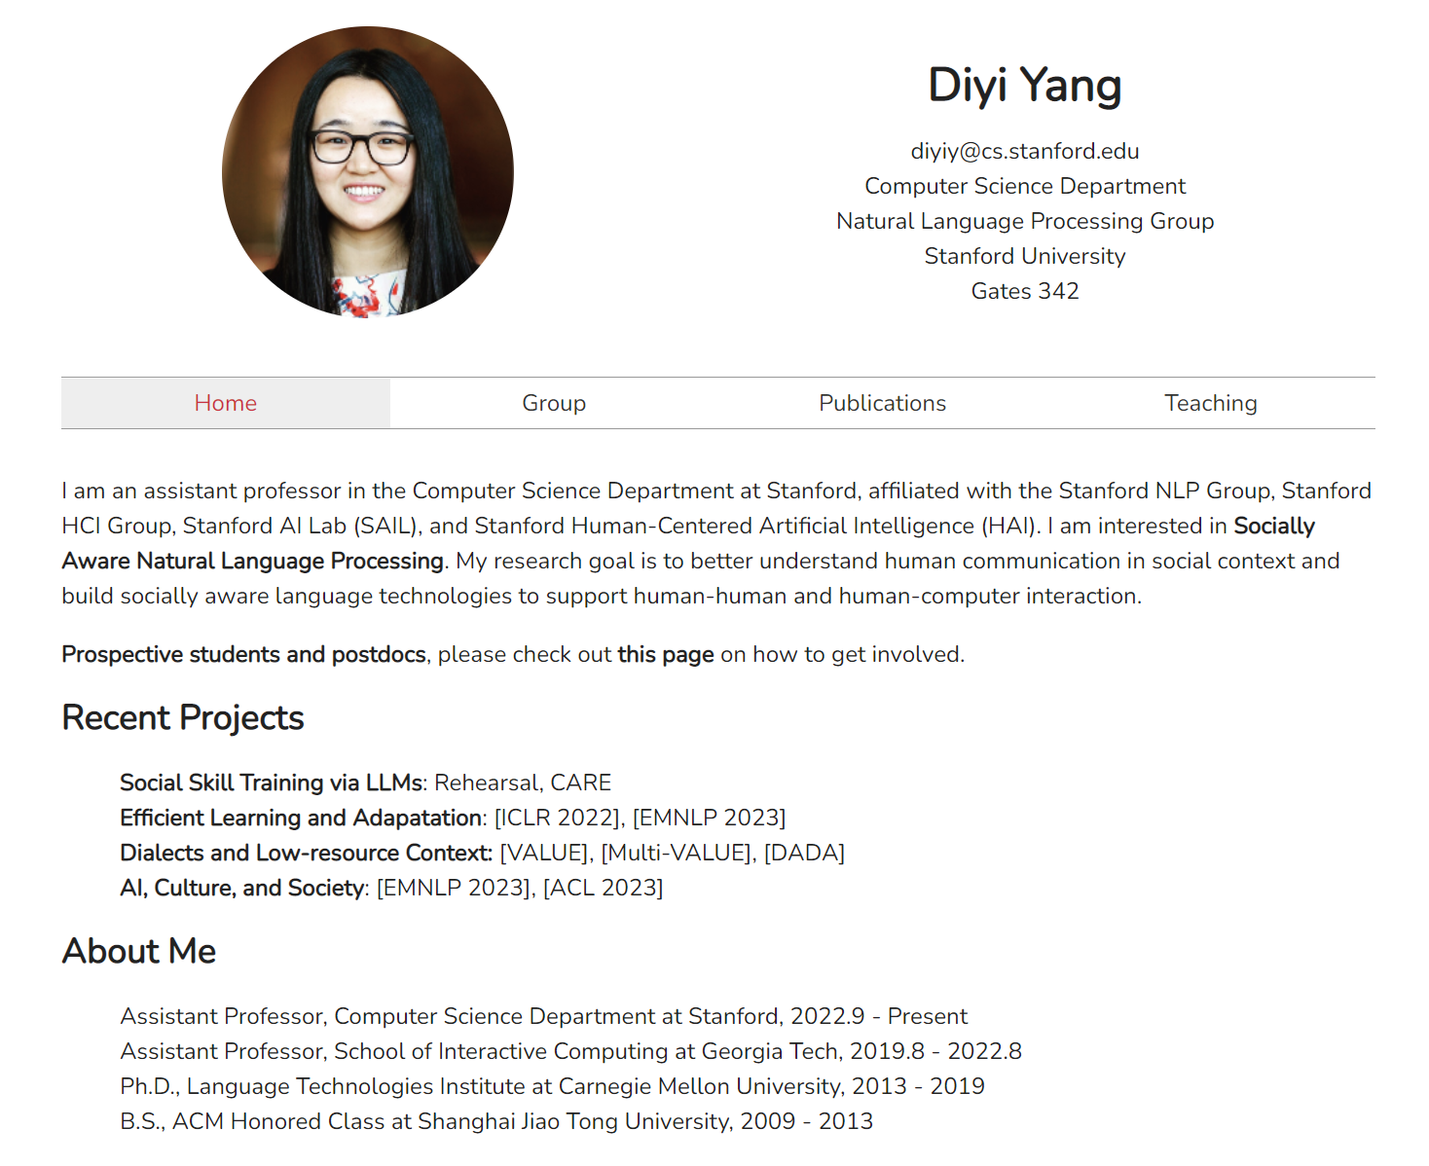

Ask ChatGPT when you are uncertain, feed it with as much context as possible
Remember that you are good, good is defined as the best outcome for everyone ☺
Extended reading – Prof. Yang’s Leading research on NLP
Helping the Helper: Supporting Peer Counselors via AI-Empowered Practice and Feedback
Introduction NLP Use-Case Vocabulary Reflection

Slide 31

What is research? What is academic journal?
Let’s read the abstract and introduction ☺
https://link.springer.com/article/10.1007/s10726-021-09738-x
Introduction NLP Use-Case Vocabulary Reflection

Slide 32
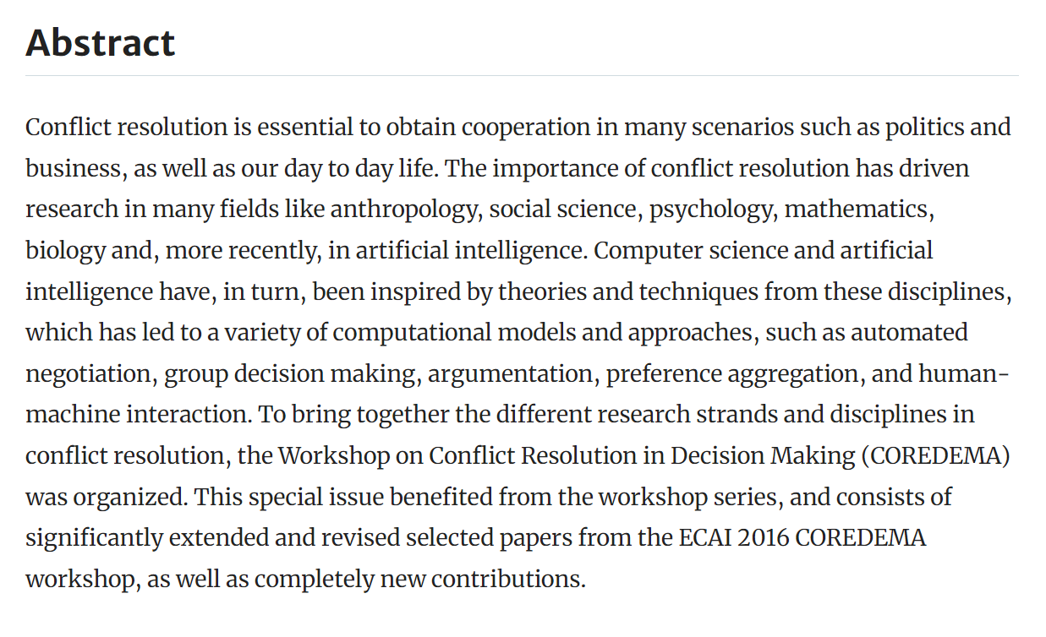
What is academic journal?
Let’s read the abstract and introduction ☺
https://link.springer.com/article/10.1007/s10726-021-09738-x
Introduction NLP Use-Case Vocabulary Reflection

Slide 33
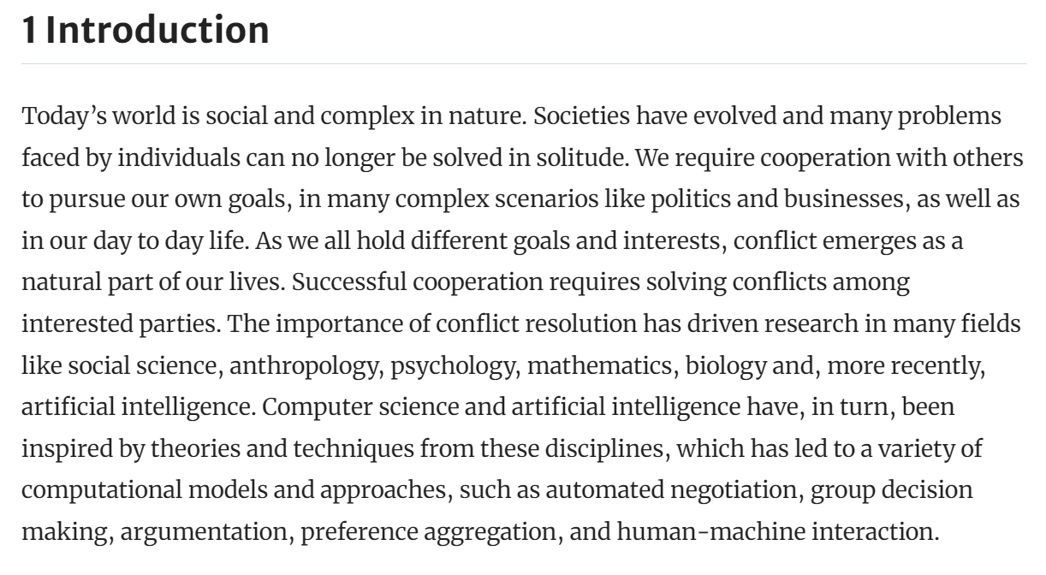
What is academic journal?
Let’s read the abstract and introduction ☺
https://link.springer.com/article/10.1007/s10726-021-09738-x
Introduction NLP Use-Case Vocabulary Reflection

Slide 34
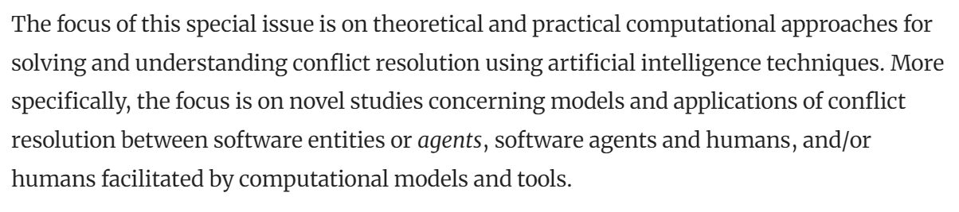
What is academic journal?
Let’s read the abstract and introduction ☺
https://link.springer.com/article/10.1007/s10726-021-09738-x
Introduction NLP Use-Case Vocabulary Reflection

Slide 35

Summary
What English have you learned? ☺
Vocab for Exam
Conflict Resolution
Natural Language Processing
Artificial Intelligence
Dialogue
Human Computer Interaction
Professor
Academic Journal
Sentence Structure
Given the fact that……(a condition),…… (a condition related to mentioned condition).
Introduction NLP Use-Case Vocabulary Reflection

Slide 36

Summary
What English have you learned? ☺
Vocab for Exam
Conflict Resolution
Natural Language Processing
Artificial Intelligence
Dialogue
Human Computer Interaction
Professor
Academic Journal
Sentence Structure
Given the fact that……(a condition),…… (a condition related to mentioned condition).
Introduction NLP Use-Case Vocabulary Reflection

Slide 37

Summary
What English have you learned? ☺
Vocab for Exam
Conflict Resolution
Natural Language Processing
Artificial Intelligence
Dialogue
Human Computer Interaction
Professor
Academic Journal
Sentence Structure
Given the fact that……(a condition),…… (a condition related to mentioned condition).
Introduction NLP Use-Case Vocabulary Reflection

Slide 38

Summary
What English have you learned? ☺
Vocab for Exam
Conflict Resolution
Natural Language Processing
Artificial Intelligence
Dialogue
Human Computer Interaction
Professor
Academic Journal
Sentence Structure
Given the fact that……(a condition),…… (a condition related to mentioned condition).
Introduction NLP Use-Case Vocabulary Reflection

Slide 39
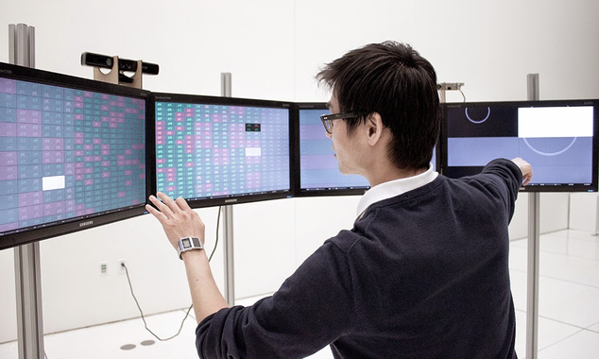
Summary
What English have you learned? ☺
Vocab for Exam
Conflict Resolution
Natural Language Processing
Artificial Intelligence
Dialogue
Human Computer Interaction
Professor
Academic Journal
Sentence Structure
Given the fact that……(a condition),…… (a condition related to mentioned condition).
Introduction NLP Use-Case Vocabulary Reflection

Slide 40
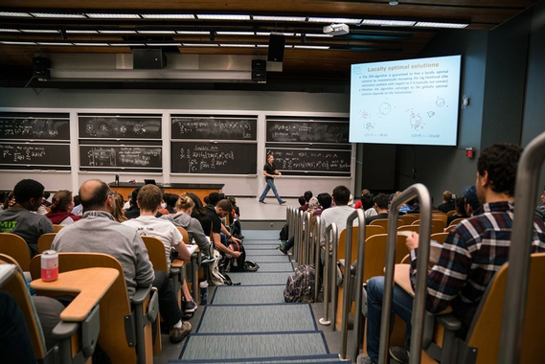
Summary
What English have you learned? ☺
Vocab for Exam
Conflict Resolution
Natural Language Processing
Artificial Intelligence
Dialogue
Human Computer Interaction
Professor
Academic Journal
Sentence Structure
Given the fact that……(a condition),…… (a condition related to mentioned condition).
Introduction NLP Use-Case Vocabulary Reflection

Slide 41

Summary
What English have you learned? ☺
Vocab for Exam
Conflict Resolution
Natural Language Processing
Artificial Intelligence
Dialogue
Human Computer Interaction
Professor
Academic Journal
Sentence Structure
Given the fact that……(a condition),…… (a condition related to mentioned condition).
Introduction NLP Use-Case Vocabulary Reflection

Slide 42
Share with me an argument you faced, and tell me the question you would ask ChatGPT
Use at least one vocabulary about AI ☺
What have we learned?
What have we learned?
What have we learned?
What have we learned?
Active participants gets a coin
Introduction NLP Use-Case Vocabulary Reflection

Slide 43


The End.
“In preparing for battle I have always found that plans are useless but planning is indispensable”
― Dwight D. Eisenhower

Slide 44

Introduction to AI Productivity
How to use ChatGPT to Realize your potential
KK

Slide 45
What are we doing here?
Executive Summary
How to study English?
Language in Analytics
Use Case Scenario
Vocabulary
Introduction Productivity Use-Case Vocabulary Reflection

Slide 46


What is Productivity?
Do you consider yourself productive as a student?
Definition of Productivity
Productivity, the amount of work you can get done in one day is your rate of productivity.
Application of AI Productivity
ChatGPT is fine-tuned from GPT-3.5, a language model trained to produce text. ChatGPT was optimized for dialogue by using Reinforcement Learning with Human Feedback (RLHF) – a method that uses human demonstrations and preference comparisons to guide the model toward desired behavior.
Compulsory Reading: https://www.mckinsey.com/featured-insights/mckinsey-explainers/what-is-productivity
Introduction Productivity Use-Case Vocabulary Reflection

Slide 47

Do you think you can study at University?
Don’t answer. If that’s your dream, ask ChatGPT how with your vocabs ☺
Introduction Productivity Use-Case Vocabulary Reflection

Slide 48
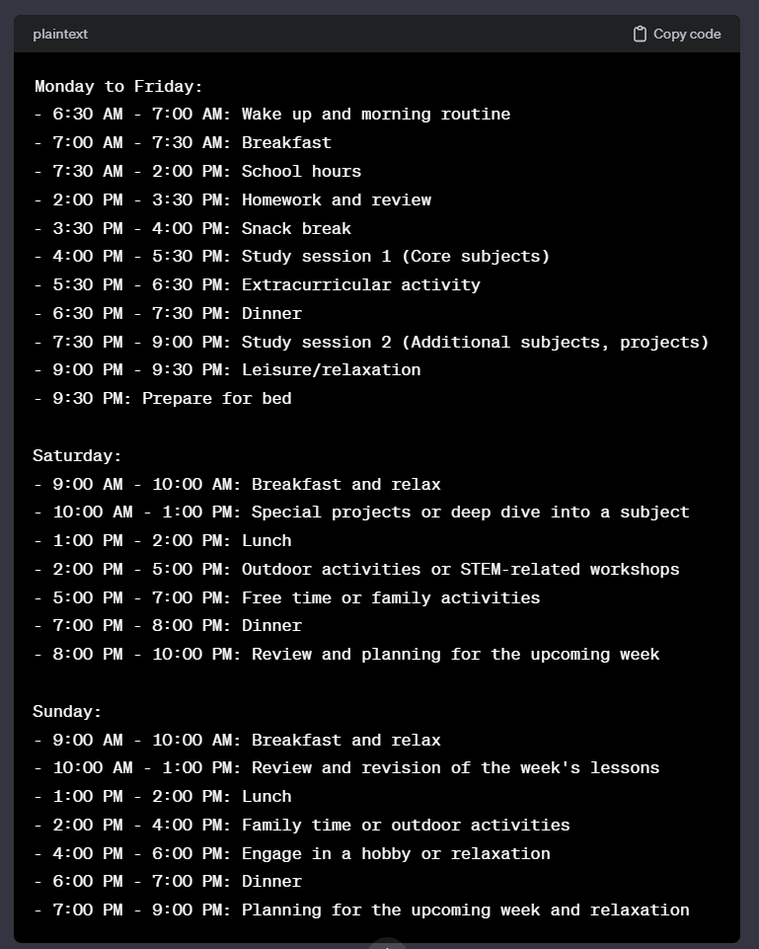
This is the answer from ChatGPT
You get the answer, but the one who is determined enough to act is you!
Year 1:
- Subjects: 1-2 hours/day for Mathematics, Science, and English.
- Extracurricular: Engage in STEM-related clubs or activities.
- Weekends: Deepen understanding of core subjects.
Year 2:
- Subjects: 2-3 hours/day, focus on core subjects and introduce additional ones.
- Projects: Undertake small projects or experiments.
- Weekends: Explore potential engineering fields.
Year 3:
- Subjects: 3-4 hours/day, introduce advanced levels of Math and Science.
- Projects: Engage in more complex projects, possibly collaborations.
- Career Guidance: Attend sessions to understand engineering disciplines.
Year 4:
- Subjects: 4-5 hours/day, focus on specialized subjects.
- Internship/Shadowing: Seek opportunities for hands-on experiences.
- University Research: Start researching potential engineering programs.
Year 5:
- Exam Preparation: 5-6 hours/day for standardized tests.
- University Applications: Prepare a strong application.
- Interview Preparation: Practice for university interviews and assessments.
Introduction Productivity Use-Case Vocabulary Reflection

Slide 49

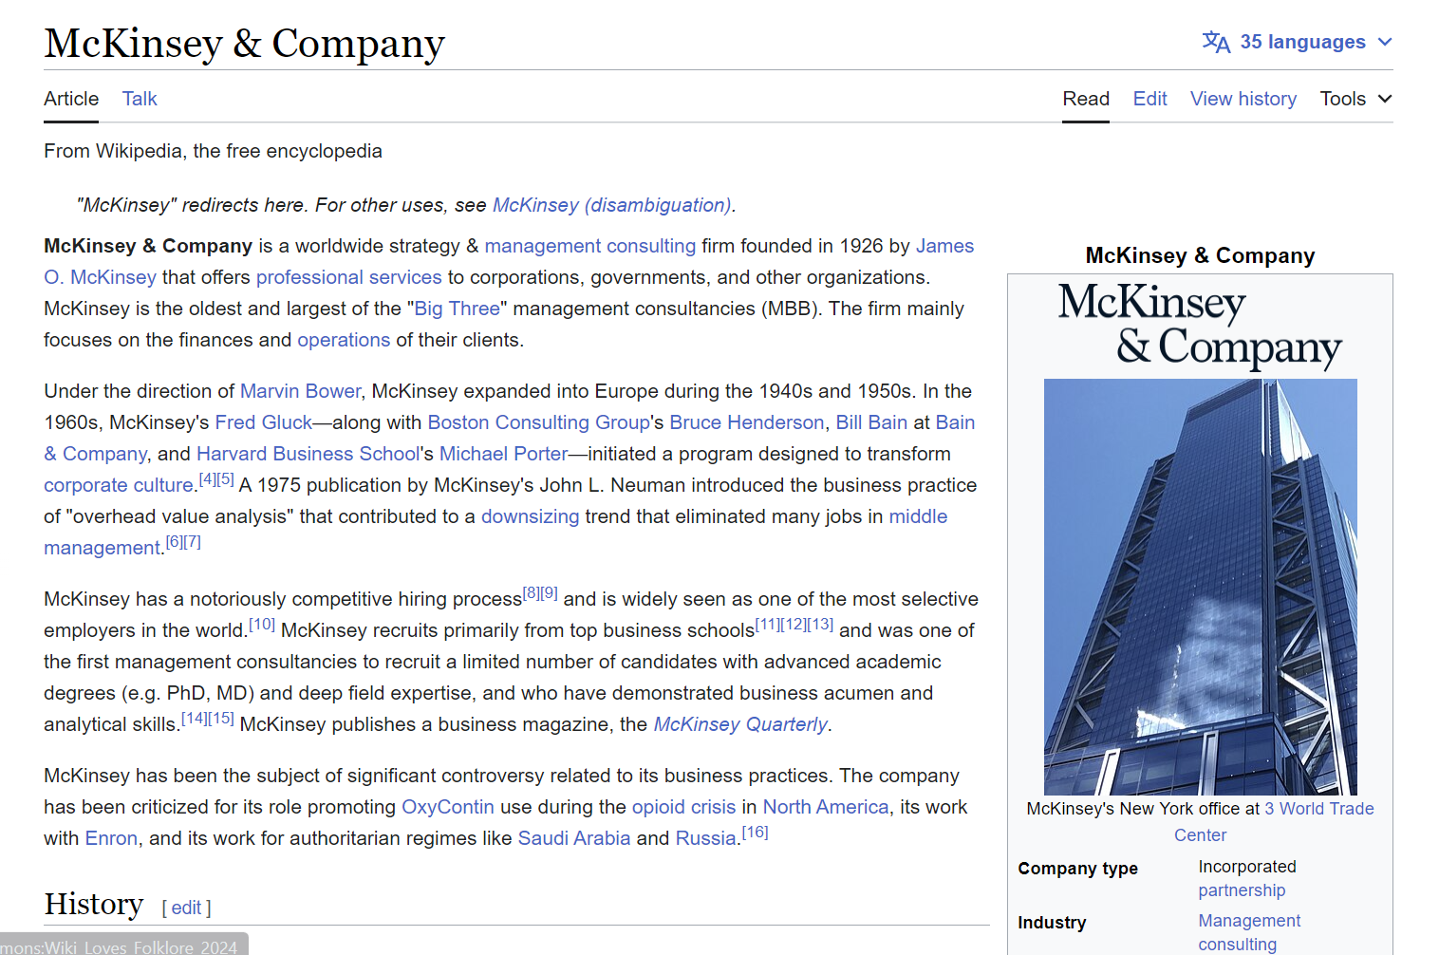
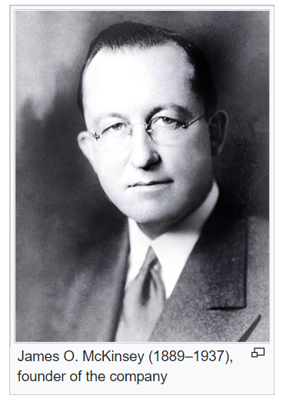
Let’s read an article about productivity by McKinsey
McKinsey is the leading management consultancy in the world
Introduction Productivity Use-Case Vocabulary Reflection

Slide 50
What is Productivity?
Let’s read the insights from McKinsey ☺
Productivity, in simple terms, measures the value created for each hour worked in a society. Whether at your desk or on a country scale, productivity plays a crucial role in determining living standards and economic success. For companies and nations, it can affect wages, the ability to operate, and overall well-being.
There are various types of productivity, such as labor productivity, which relates to the ratio of GDP per total hours worked. Other types include capital productivity, focusing on the efficient use of physical capital, and total factor productivity, driven by innovation.
In advanced countries like the United States and Western Europe, productivity growth has been slowing down since the 1960s. Reasons vary, from the aftermath of financial crises to challenges in sectors with accelerated growth. Some experts believe this slowdown is due to factors like incomplete digitization or the belief that the age of great innovation has passed.
Introduction Productivity Use-Case Vocabulary Reflection

Slide 51
What is Productivity?
Let’s read the insights from McKinsey ☺
The COVID-19 pandemic further impacted productivity, causing economic disruption. However, there is potential for a post-pandemic boost if businesses and policymakers take bold actions. These actions should focus on sustaining innovation, supporting employment and wages, and increasing investment in areas like sustainability and infrastructure.
Investments in intangibles, such as intellectual property and human capital, are crucial for productivity growth in the knowledge and digital economies. A focus on productivity growth also helps countries diversify their economies, reducing dependence on a single sector and promoting sustainability.
In conclusion, understanding and addressing productivity are essential for individuals, organizations, and nations to thrive. By embracing digital transitions, fostering innovation, and making strategic investments, we can work towards a future of increased productivity and economic growth.
Introduction Productivity Use-Case Vocabulary Reflection

Slide 52

Summary
What English have you learned? ☺
Vocab for Exam
Productivity
Schedule
Innovation
Consulting
Rigid
Hectic
Tactfully
Sentence Structure
Given the fact that……(a condition),…… (a condition related to mentioned condition).
Introduction Productivity Use-Case Vocabulary Reflection

Slide 53

Summary
What English have you learned? ☺
Vocab for Exam
Productivity
Schedule
Innovation
Consulting
Rigid
Hectic
Tactfully
Sentence Structure
Given the fact that……(a condition),…… (a condition related to mentioned condition).
Introduction Productivity Use-Case Vocabulary Reflection

Slide 54

Summary
What English have you learned? ☺
Vocab for Exam
Productivity
Schedule
Innovation
Consulting
Rigid
Hectic
Tactfully
Sentence Structure
Given the fact that……(a condition),…… (a condition related to mentioned condition).
Introduction Productivity Use-Case Vocabulary Reflection

Slide 55

Summary
What English have you learned? ☺
Vocab for Exam
Productivity
Schedule
Innovation
Consulting
Rigid
Hectic
Tactfully
Sentence Structure
Given the fact that……(a condition),…… (a condition related to mentioned condition).
Introduction Productivity Use-Case Vocabulary Reflection

Slide 56
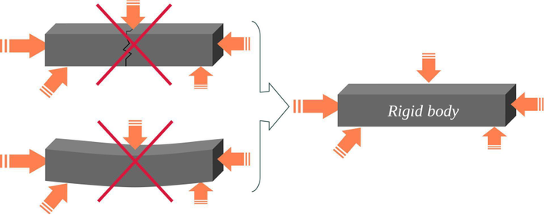
Summary
What English have you learned? ☺
Vocab for Exam
Productivity
Schedule
Innovation
Consulting
Rigid
Hectic
Tactfully
Sentence Structure
Given the fact that……(a condition),…… (a condition related to mentioned condition).
Introduction Productivity Use-Case Vocabulary Reflection

Slide 57

Summary
What English have you learned? ☺
Vocab for Exam
Productivity
Schedule
Innovation
Consulting
Rigid
Hectic
Tactfully
Sentence Structure
Given the fact that……(a condition),…… (a condition related to mentioned condition).
Introduction Productivity Use-Case Vocabulary Reflection

Slide 58

Summary
What English have you learned? ☺
Vocab for Exam
Productivity
Schedule
Innovation
Consulting
Rigid
Hectic
Tactfully
Sentence Structure
Given the fact that……(a condition),…… (a condition related to mentioned condition).
Introduction Productivity Use-Case Vocabulary Reflection

Slide 59
Tell me how can you be more productive with AI
Use at least one vocabulary about AI ☺
What have we learned?
What have we learned?
What have we learned?
What have we learned?
Active participants gets a coin
Introduction Productivity Use-Case Vocabulary Reflection

Slide 60

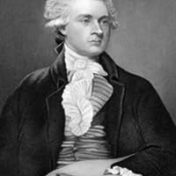
The End.
“I find that the harder I work , the more luck I seem to have.”
― Thomas Jefferson

Slide 61

Final Lesson – Work Hard on Your Dreams
Use ChatGPT and your vocabs to ask for procedures
KK

Slide 62
Summary
This is all the vocabularies you have learned!!! ☺
Vocab for Exam
Optimization
Data Analysis
Structured Data Models
Raw Data
Text Mining
Systematically
Interpret
Conflict Resolution
Natural Language Processing
Artificial Intelligence
Dialogue
Human Computer Interaction
Professor
Academic Journal
Productivity
Schedule
Innovation
Consulting
Rigid
Hectic
Tactfully
Your Vocabulary Your Dream Our Task

Slide 63
Additional examples of conditional sentences
Below is a list of more conditional sentence you could use
Conditional Sentence
Given the fact that……(a condition),…… (a condition related to mentioned condition).
Since… (a condition), … (a condition related to mentioned condition).
Due to…(a condition), … (a condition related to mentioned condition).
Considering… (a condition), … (a condition related to mentioned condition).
If… (a condition), ... (a condition related to mentioned condition).
Had I… (a condition), … (a condition related to mentioned condition).
Had I not… (a condition), … (a condition related to mentioned condition).
由於...（某種情況），...（與提到的情況相關的條件）。
因為...（某種情況），...（與提到的情況相關的條件）。
由於...（某種情況），...（與提到的情況相關的條件）。
考慮到...（某種情況），...（與提到的情況相關的條件）。
如果...（某種情況），...（與提到的情況相關的條件）。
假如我...（某種情況），...（與提到的情況相關的條件）。
假如我冇...（某種情況），...（與提到的情況相關的條件）。
Your Vocabulary Your Dream Our Task

Slide 64

How do you want to achieve your dream?
We will use ChatGPT to plan your journey – one by one ☺
Name
Name
Name
Name

Slide 65
Steps to realize your dream!
Each of you got one chance, and you must use one vocab we’ve learned ☺
Charles Lee
Tom Lee
Carrie Ma
Bryant Lee
Your Vocabulary Your Dream Our Task

Slide 66
The time is yours. Ask me anything you want to know/my help in pursuing your dream
Each of you got one chance, and you must use one vocab we’ve learned ☺
Charles Lee
Tom Lee
Carrie Ma
Bryant Lee
Your Vocabulary Your Dream Our Task

Slide 67

You can do it!
Believe in Yourselves and All the Best!
― KK, Your Tutor

